Slide 1
SEM 2018 Annual Meeting, June 4 – June 7, 2018, Greenville, SC USA
Dynamic Thermal Softening Behavior of Additive Materials for Hybrid Manufacturing
Steven Mates¹, Mark Stoudt¹, Gregor Jacob¹, Wilfredo Moscoso-Kingsley² and Vis Madhavan²
¹NIST, 100 Bureau Drive, Gaithersburg, MD, USA
²Wichita State University, Wichita, KS, USA
Notes:
As you may able to infer from the graphics and title, we are interested in measuring dynamic properties of this material to help better understand machining processes.
We started the project a bit over 10 years ago, and recently we’ve been given a pretty good morale boost from the MGI, discussed in some detail here at this meeting, which seeks to speed introduction of new materials to the economy, with manufacturing playing a critical role.

Slide 2
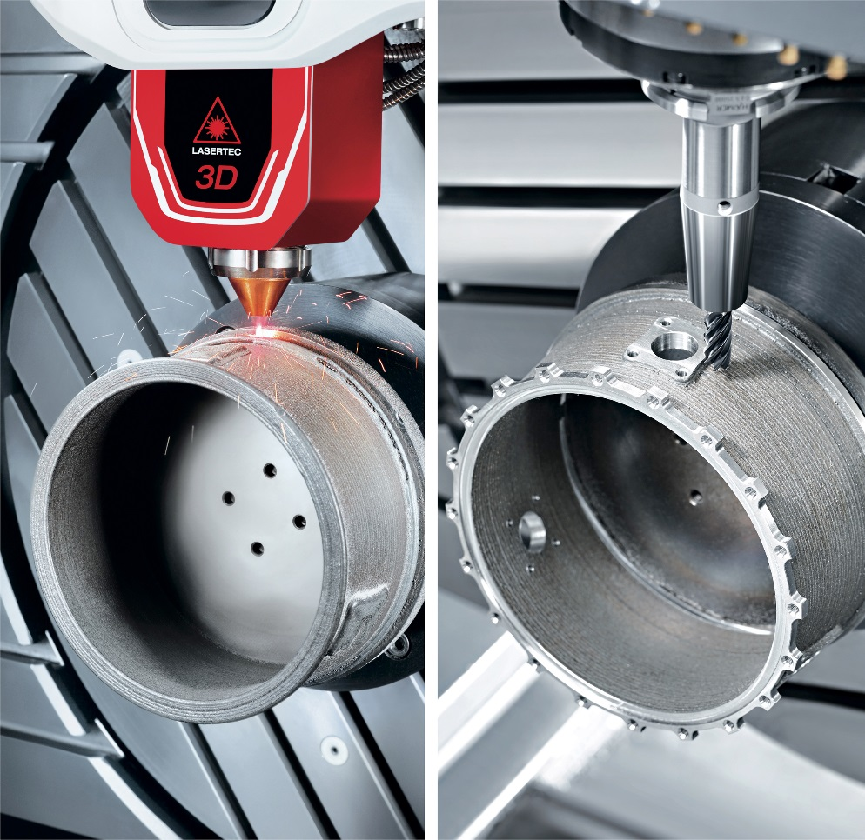
What is Hybrid Manufacturing?
Hybrid manufacturing is a combination of additive and subtractive manufacturing
Adds capability
Improves surface finish
Increases dimensional tolerances (?)
http://www.fabricatingandmetalworking.com/2017/02/hybrid-machine-tools/

Slide 3
Machinability of Additively-Produced Materials
Machinability can be a critical barrier to new material deployment
Additive material properties can be quite different than their traditionally-processed counterparts, and therefore might be considered “new materials”
How different are additive materials from wrought under dynamic loading and heating conditions?

Slide 4
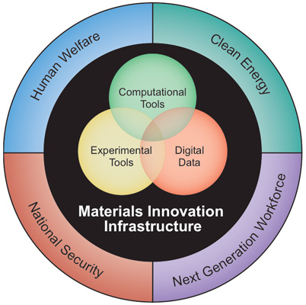
Materials Genome Initiative
“…to discover, manufacture, and deploy advanced materials twice as fast, at a fraction of the cost.”
-www.whitehouse.gov/mgi
Notes:
This project seeks to provide data relevant to understanding machining processes. It began a bit over 10 years ago, has received a recent boost from the MGI, discussed in some detail here at this meeting, which seeks to speed introduction of new materials to the economy, with manufacturing playing a critical role.

Slide 5
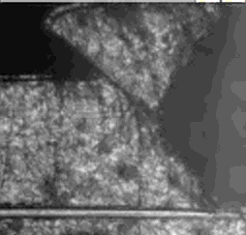
Conditions During Machining
Workpiece material is subject to extreme loading
Plastic Strains to 500%
Strain rates to 10⁶ /s
Temperatures to 1000 °C
Heating rates to 10⁶ °C/s
Tool
Titanium, 1 m/s feed rate,
0.5 mm cut depth
Notes:
Traditional and high speed machining will remain critical to the manufacturing infrastructure that is responsible for deploying new materials. Our interest is to provide data more relevant to the conditions seen by the workpiece than more traditional techniques.

Slide 6
One Big Caveat
High temperature Kolsky bar testing is NOT a perfect surrogate for machining
However, it helps us learn a lot about how temperature (and time) and strain rate affect plastic flow
Tool
Titanium, 1 m/s feed rate,
0.5 mm cut depth

Slide 7
Outline
Material behavior during machining
Time-dependent material strength?
NIST’s Pulse-Heated Kolsky Bar
Experimental Technique
Comparison of two wrought and additive alloys
Inconel 625 (Ni-Based Superalloy)
17-4 PH Stainless Steel

Slide 8
Possible Sources of Time-Dependent Material Strength
Transformations involving the rearrangement of atoms or dislocations that cause changes in mechanical properties, such as:
Annealing/Re-Crystallization/Grain Growth
Dynamic Strain Aging
Phase Decomposition/Transformation
Most visco-plastic constitutive models assume constant structure and nearly all are time-invariant
Notes:
Define thermal transformation – something that changes the metallurgical structure over time – rearrangement of constituents or dislocations causing changes in the mechanical properties.
Model development appears to have raced ahead of data here – complex models using internal state variables can include all these effects, but there are no data to populate them

Slide 9
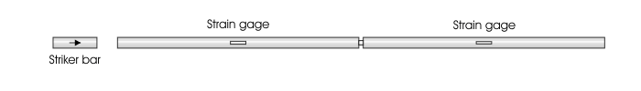
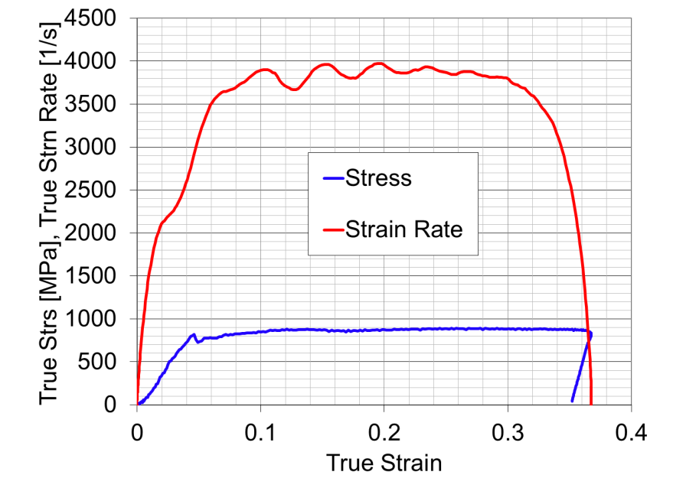
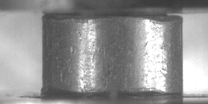
Kolsky Bar: Basic Mechanics
Test Sample
Pulses Travel at the Speed of Sound in Steel (~ 5000 m/s)
Strain gage data are used to calculate
the material’s dynamic behavior
But, the deformation velocity is only about half the striker velocity
(~ 8 m/s here)
4000 strain/s
Stress-strain curve to 35% plastic strain
2 mm thick sample
at 30,000 frames per second
Notes:
Whole tests lasts about 0.1 milliseconds
Simple compression. Also have the ability to work in tension.

Slide 10
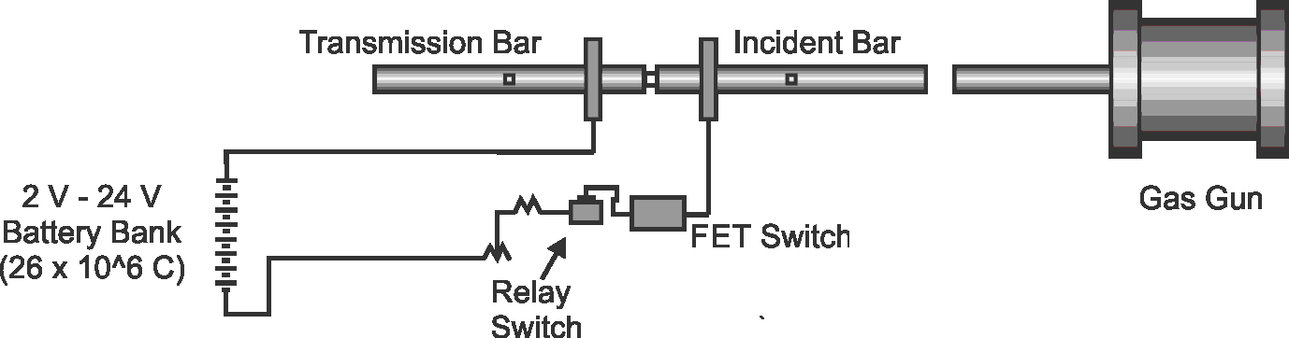
Pulse-Heated Compression Kolsky Bar
Rapid heating followed immediately by a high strain rate mechanical test
Capability to interrupt time-dependent metallurgical processes to study non-equilibrium mechanical behavior
Mates, SP; et al., EXPERIMENTAL MECHANICS, 48 [6], 799-807, 2008

Slide 11
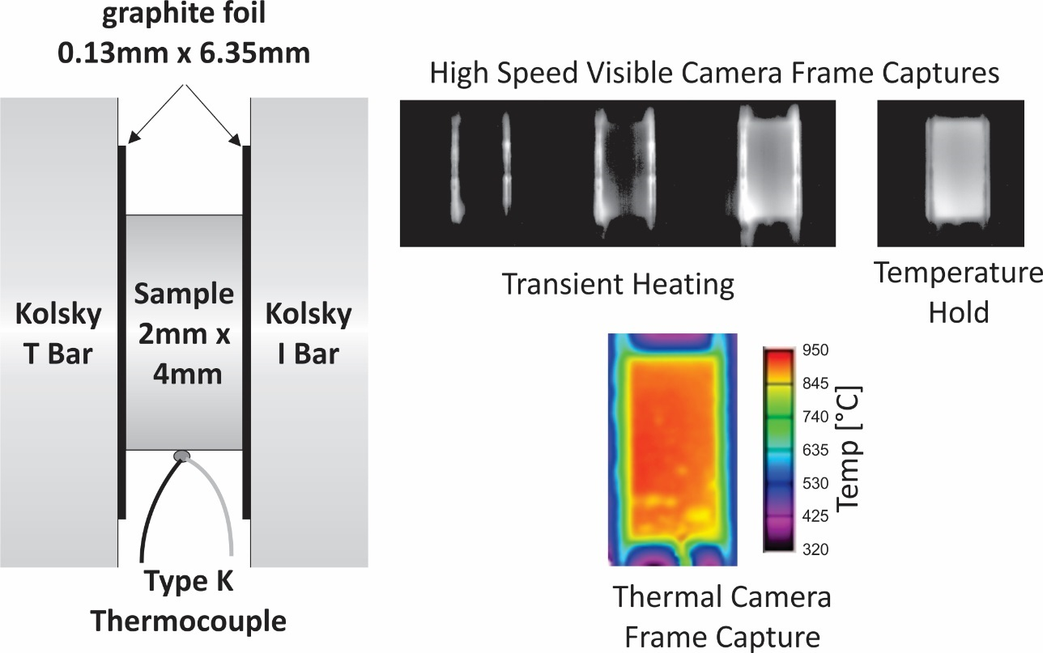

Pulse-Heating Technique
30,000 fps movie, heating to 800 °C in 1 sec with 2 second hold prior to impact
Graphite foil facilitates uniform heating and prevents arcing that can weld the specimen to the bars

Slide 12

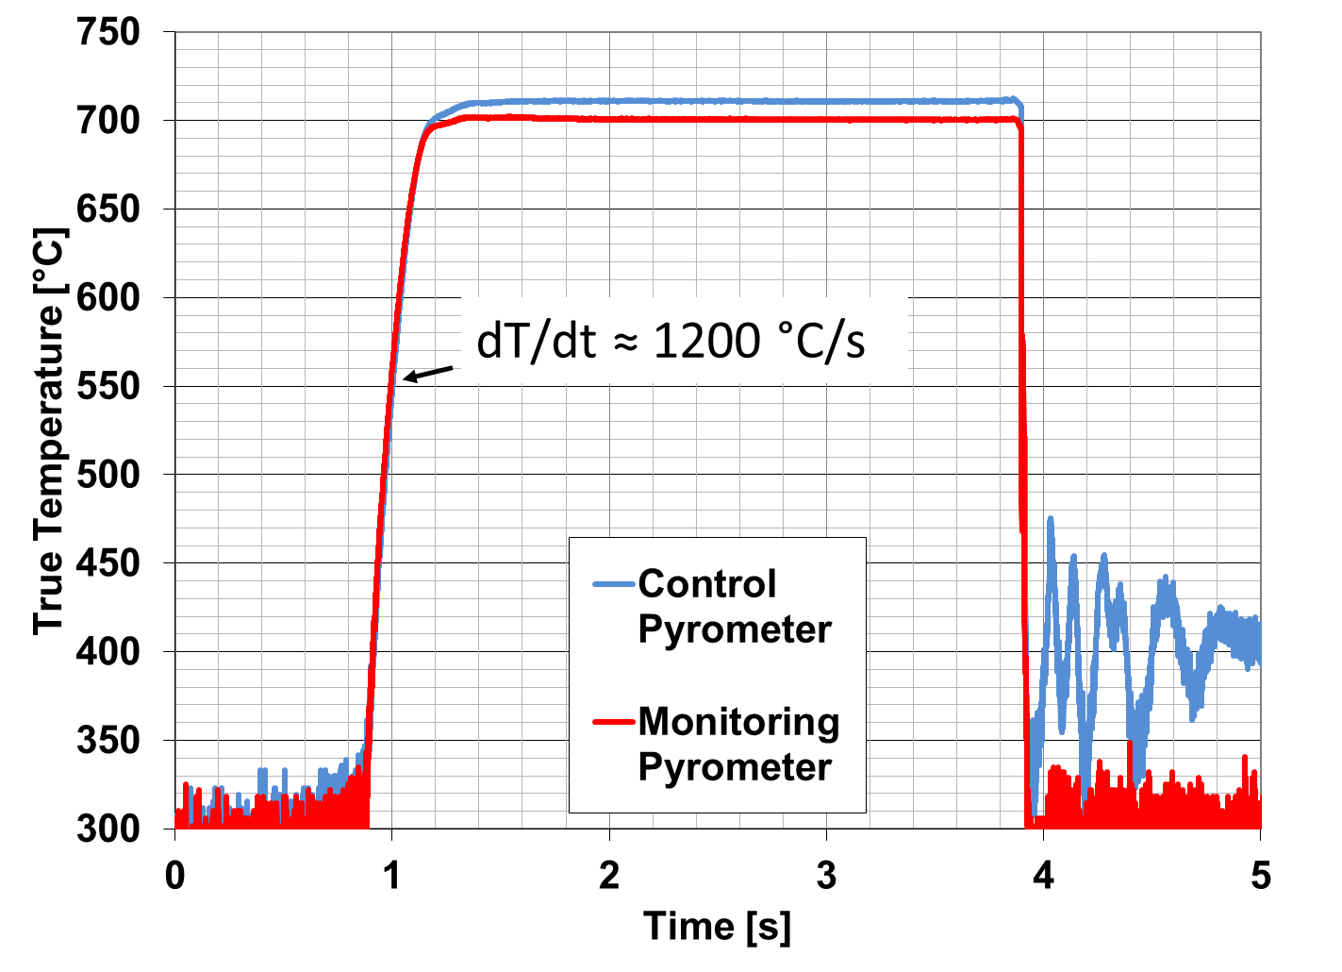
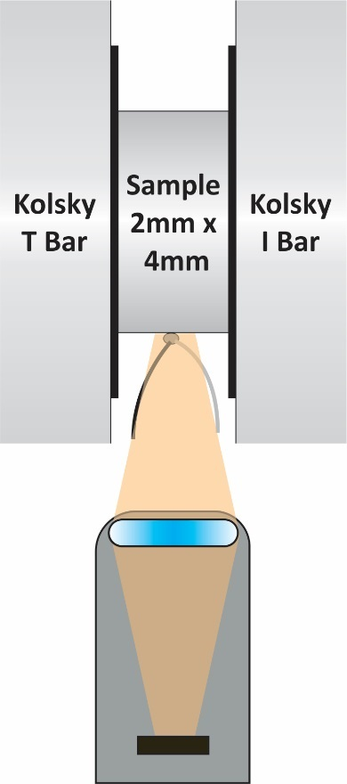
Temperature Measurement
Duplicate
Monitoring
Pyrometer
IMPACT
Temperature Uniformity is monitored while heating (uniformity typically 5 °C – 10 °C)
Control
Pyrometer
Notes:
Note that pyrometer measurements are required because of the electrical noise on the TC renders it unreliable until the current is switched off. Maybe too much detail. But it explains why we need the pyro in the first place, not just the TC

Slide 13
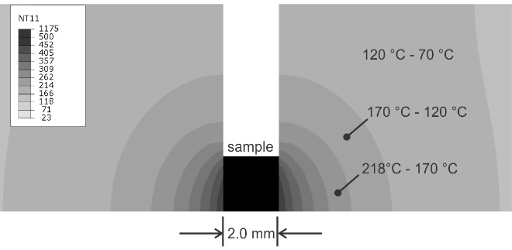
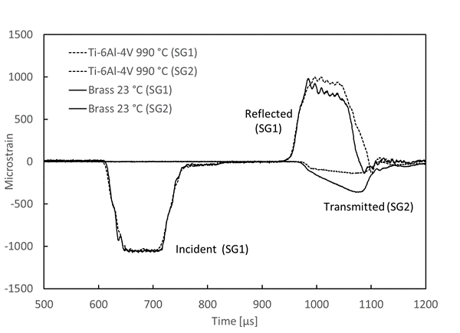
Bar Heating Effects
FEA Estimate of heat affected zone in the bars
Simulation of Bar Internal Temperature Distribution
(1000 °C, 7 Seconds)
Localized heating does not distort Kolsky bar waves

Slide 14
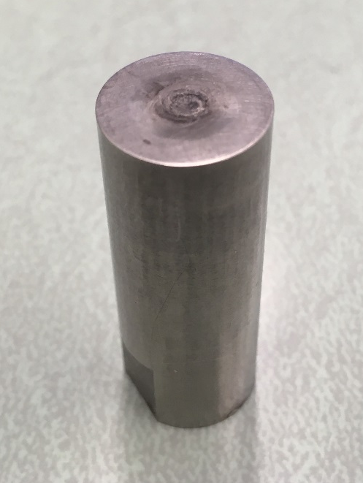
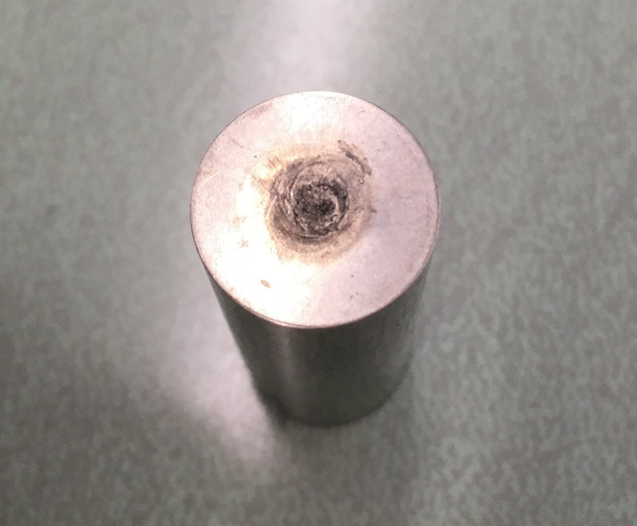
Sacrificial Bar Tips
Repeated testing at very high temperatures causes damage to the bar surface in the heat affected zone
Replaceable tips are used to simplify repairs
Notes:
This damage looks pretty bad but...

Slide 15
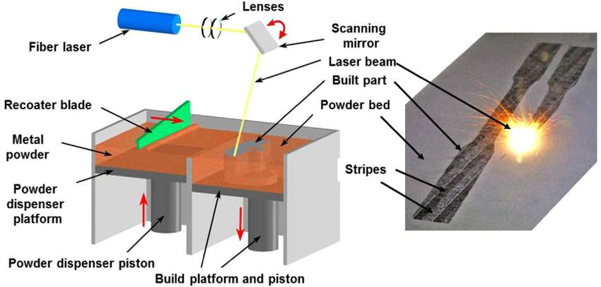
Additive Process: Laser Powder Bed Fusion (PBF)
Solidification Microstructure
L. Criales, Y. Arisoy, B. Lane, S. Moylan,
A. Donmez, T. Özel. (2017) Int. J. Mach Tool Manu
Solidification of AM material occurs under very different thermo-mechanical conditions compared to wrought.
Large effort underway to predict AM solidification behavior (REF?)

Slide 16
17-4 PH Wrought vs. Additive

Slide 17
Physical Metallurgy of Wrought 17-4 PH
Fe-Cr₁₆-Ni₄-Cu₄ + minor constituents
Lath martensitic structure (BCC)
Heat treatable – Cu precipitates, Nb & Cr carbides
BCC-FCC transformation temperature (A1≈750 ˚C)
Lath martensite (BCC)
Cheruvathur, S., Lass, E., Campbell, C., JOM 2016, DOI: 10.1007/s11837-015-1754-4

Slide 18
Physical Metallurgy of Additive (PBF) 17-4 PH
Build conditions:
195 W laser power
800 mm/s scan speed
20 µm layer thickness
100 µm hatch spacing
Stress relief: 650 ˚C for 1 hour
Microstructural features:
Dendritic solidification microstructure with inter-layer boundaries
BCC/FCC mixture
Inter-dendritic micro-segregation
Solidification Microstructure
Cheruvathur, S., Lass, E., Campbell, C., JOM 2016, DOI: 10.1007/s11837-015-1754-4

Slide 19
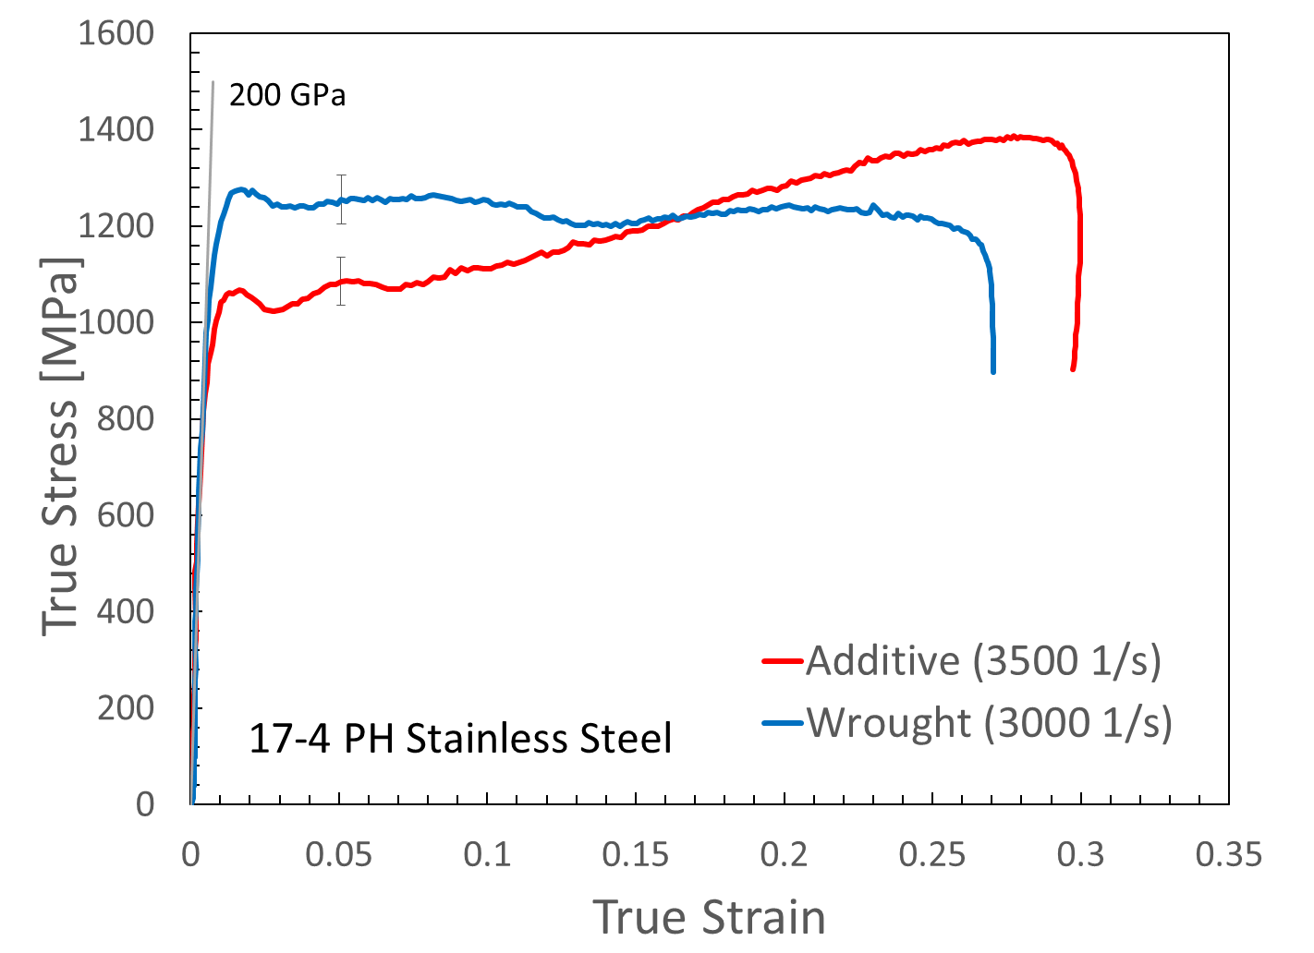
Results: 17-4 PH Stainless Steel
Room Temperature Kolsky Bar Compression Tests
Wrought 17-4 (BCC): higher yield & little/no strain hardening
Additive 17-4 (BCC/FCC): lower yield, extensive strain hardening
Significant amount of FCC (austenite) in the AM material leads to very different plastic behavior

Slide 20
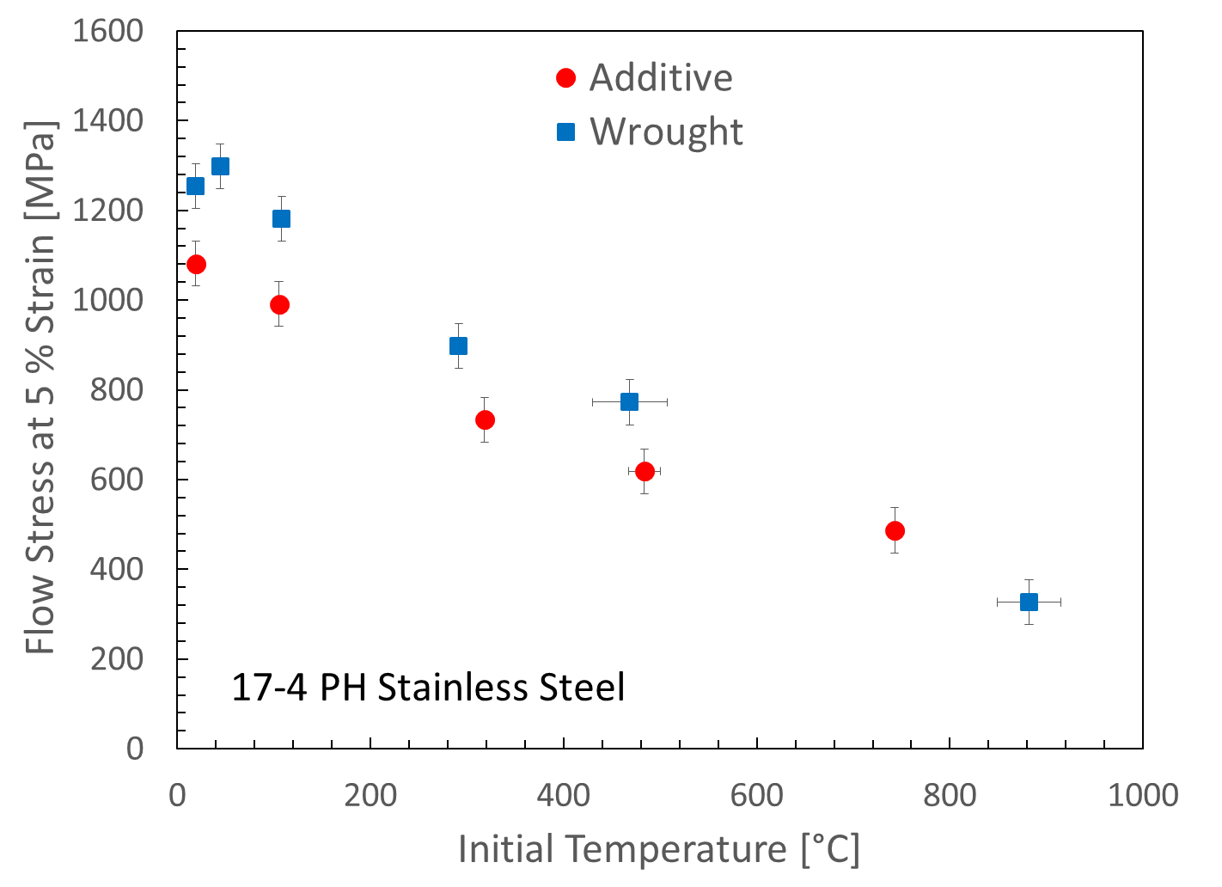
Results: 17-4 PH Stainless Steel
Elevated temperature Kolsky Bar compression tests @ fixed strain
5% strain response plotted to highlight higher initial yield stress of wrought
Thermal softening rate is roughly similar
Responses converge near 750 ˚C, the BCC – FCC transformation temperature
BCC/FCC
FCC
750 ˚C

Slide 21
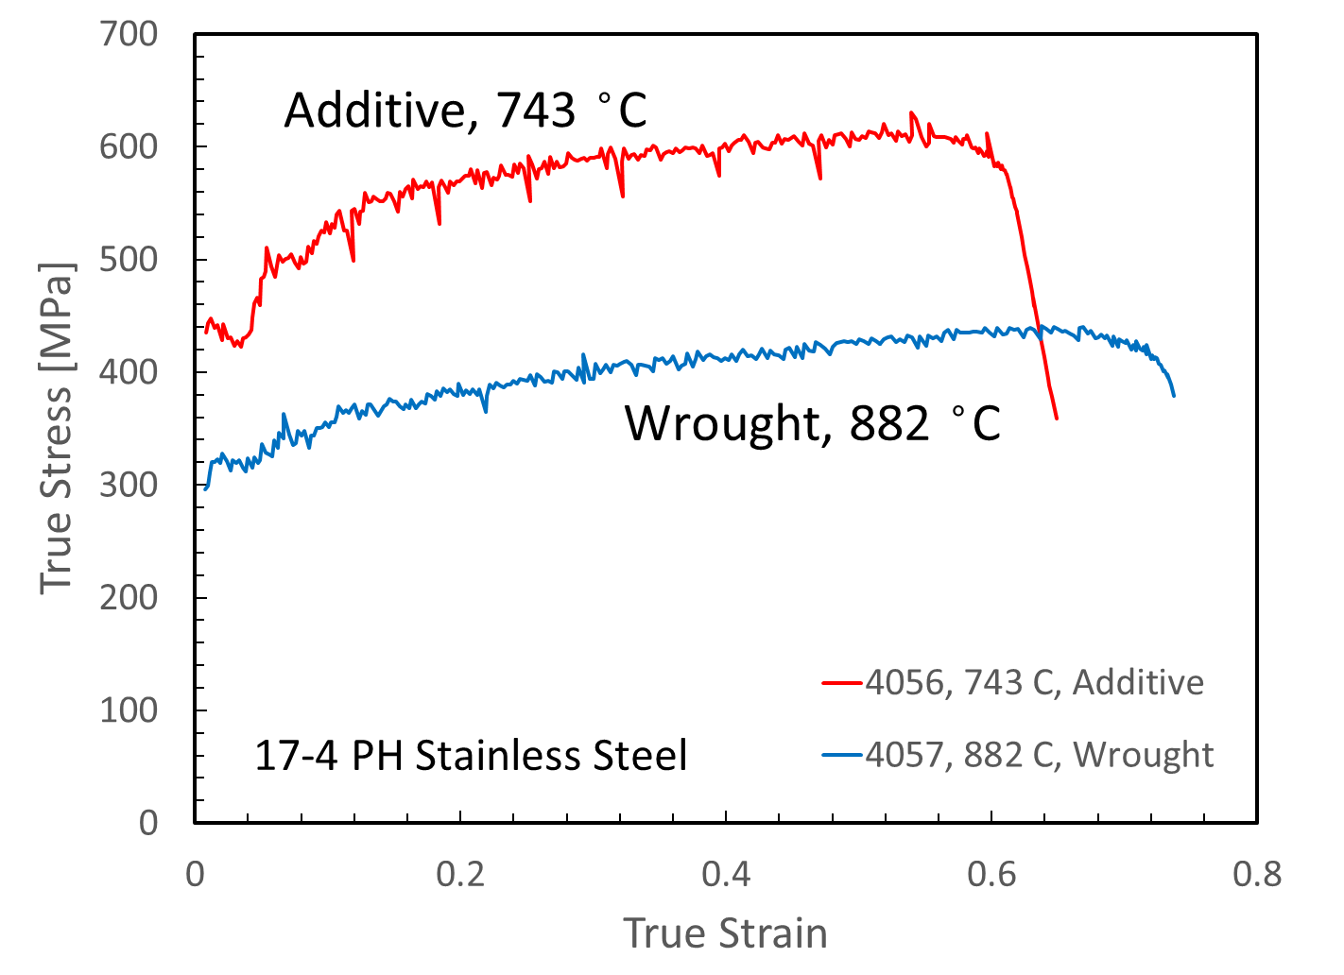
Results: 17-4 PH Stainless Steel
POSSIBLY DELETE
Harden behavior becomes similar between AM and Wrought in near and above A1 (750 ˚C)
Consistent with a transition to FCC hardening

Slide 22
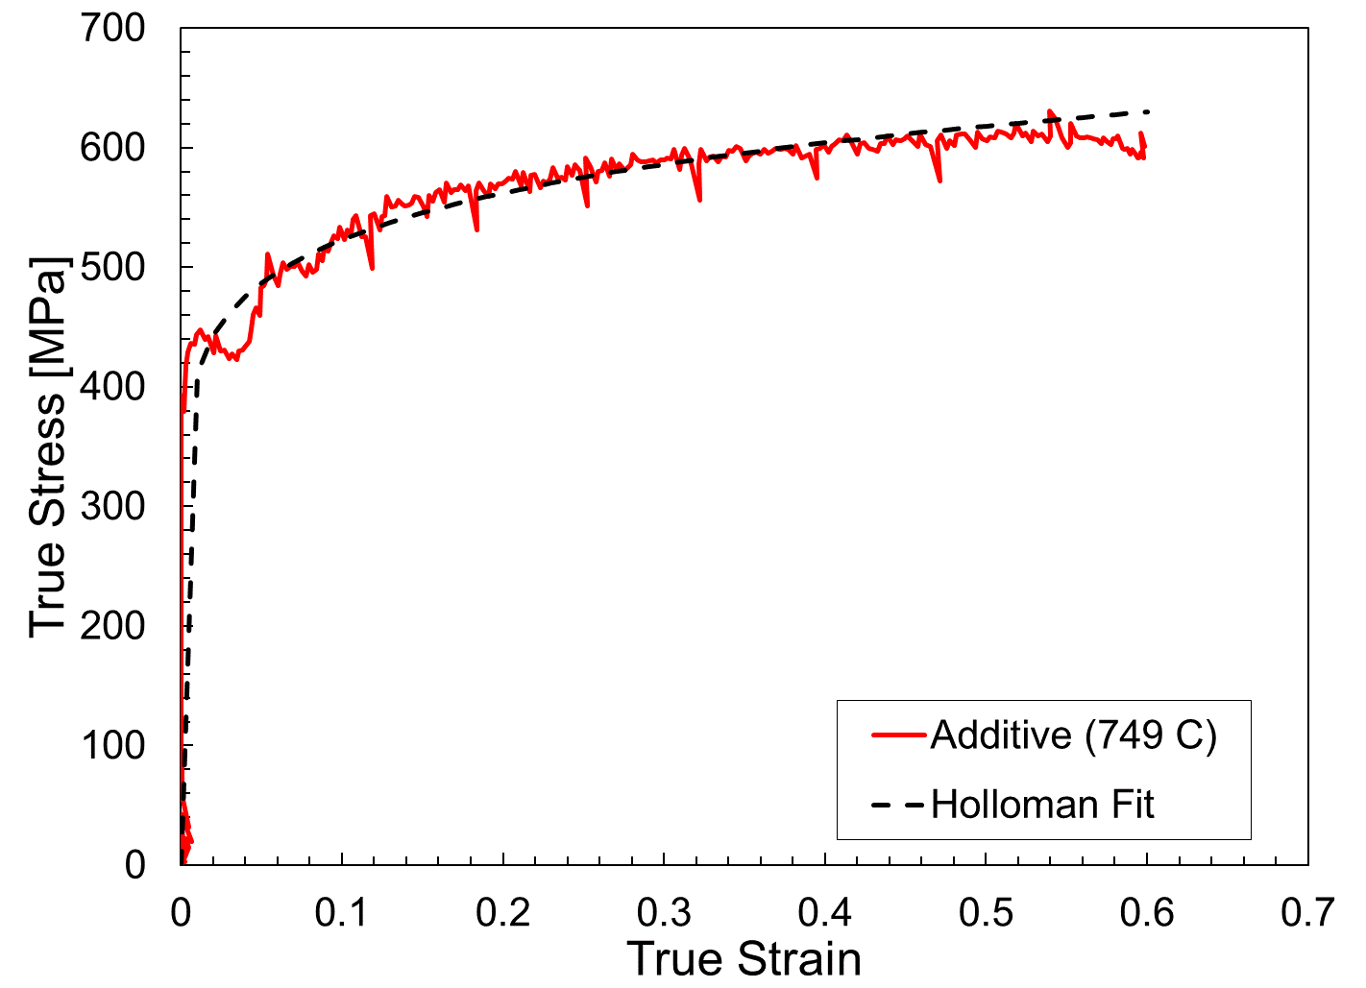
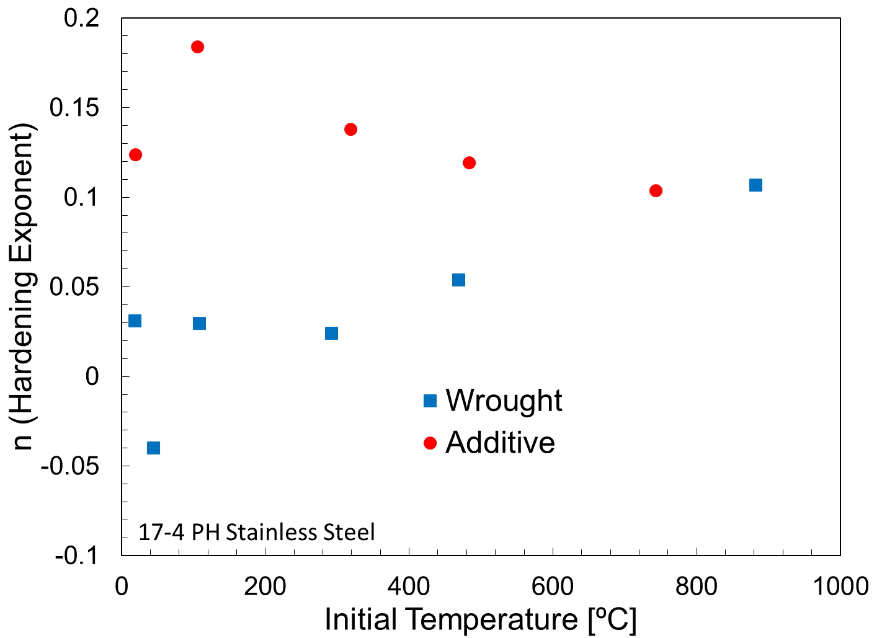
Results: 17-4 PH Stainless Steel
Additive 17-4 PH SS shows more strain hardening than wrought at low temperatures, but similar hardening near and above A1
σ = κε^{n}
FCC
Consistent with the presence of significant FCC (austenite) in the additive material, and transformation to FCC at elevated temperature
750 ˚C

Slide 23
Inconel 625 Wrought vs. Additive

Slide 24
Physical Metallurgy of Wrought Inconel 625 (IN625)
Ni-Cr₂₁-Mo₉-Nb₄ + minor constituents
Single phase FCC
Deleterious intermetallic phases (BCT γ˝: D0₂₂-Ni₃Nb and orthorhombic δ: D0_{a}-Ni₃Nb) and carbides can form for extended high temperature exposure: γ˝ : 550 ˚C, δ :750 ˚C
Intermetallics and carbides dissolve near 1200 ˚C
Single Phase FCC
Floreen, S., Fuchs, G.E and Yang, W.J., Superalloys 718, 625,
706 and Various Derivatives (TMS: Warrendale, PA, 1994).

Slide 25
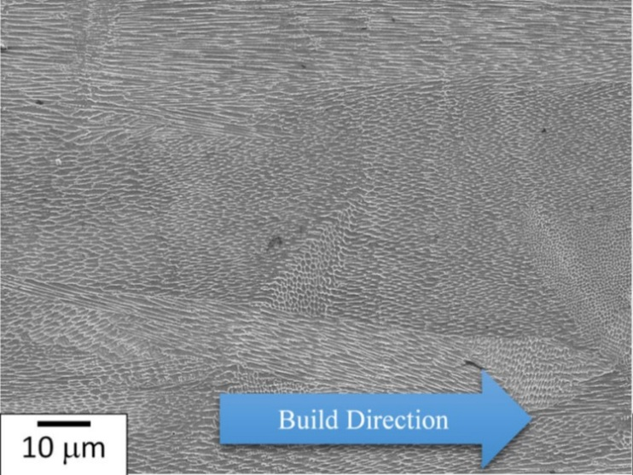
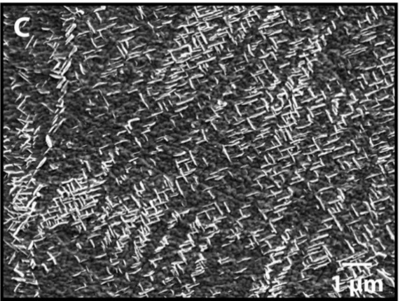
Physical Metallurgy of Additive (PBF) IN625
Build conditions:
195 W laser power
800 mm/s scan speed
20 µm layer thickness
100 µm hatch spacing
Stress relief: 870 ˚C for 1 hour
Microstructural features:
Dendritic/cellular solidification microstructure
FCC with δ-phase
Inter-dendritic segregation during solidification promotes intermetallic/carbide formation
Solidification Microstructure
δ-phase
Lass, E.A., Stoudt, M.R., Williams, M.E. et al. Metall and Mat Trans A (2017) 48: 5547. https://doi.org/10.1007/s11661-017-4304-6

Slide 26
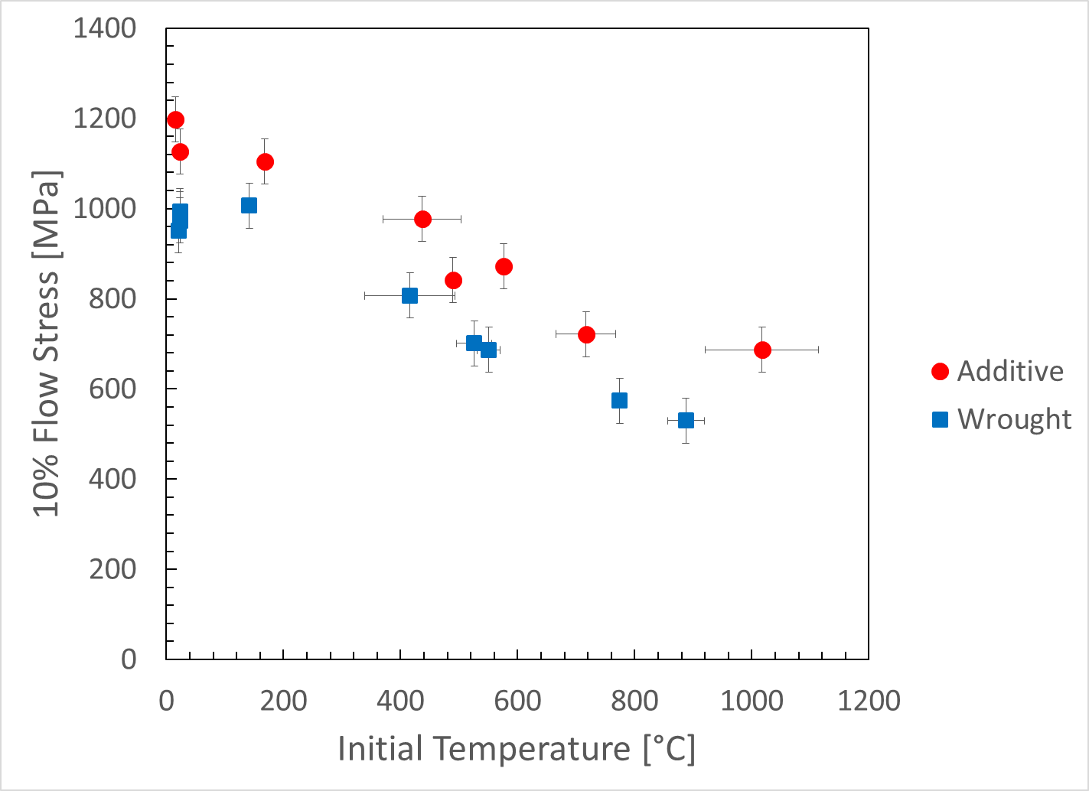
Results: Inconel 625
Elevated temperature Kolsky Bar compression tests @ fixed strain
Additively-produced material is stronger over entire range tested (to about 1000 ˚C)
δ and γ˝ intermetallics and carbides (if present)
are stable to 1200 ºC

Slide 27
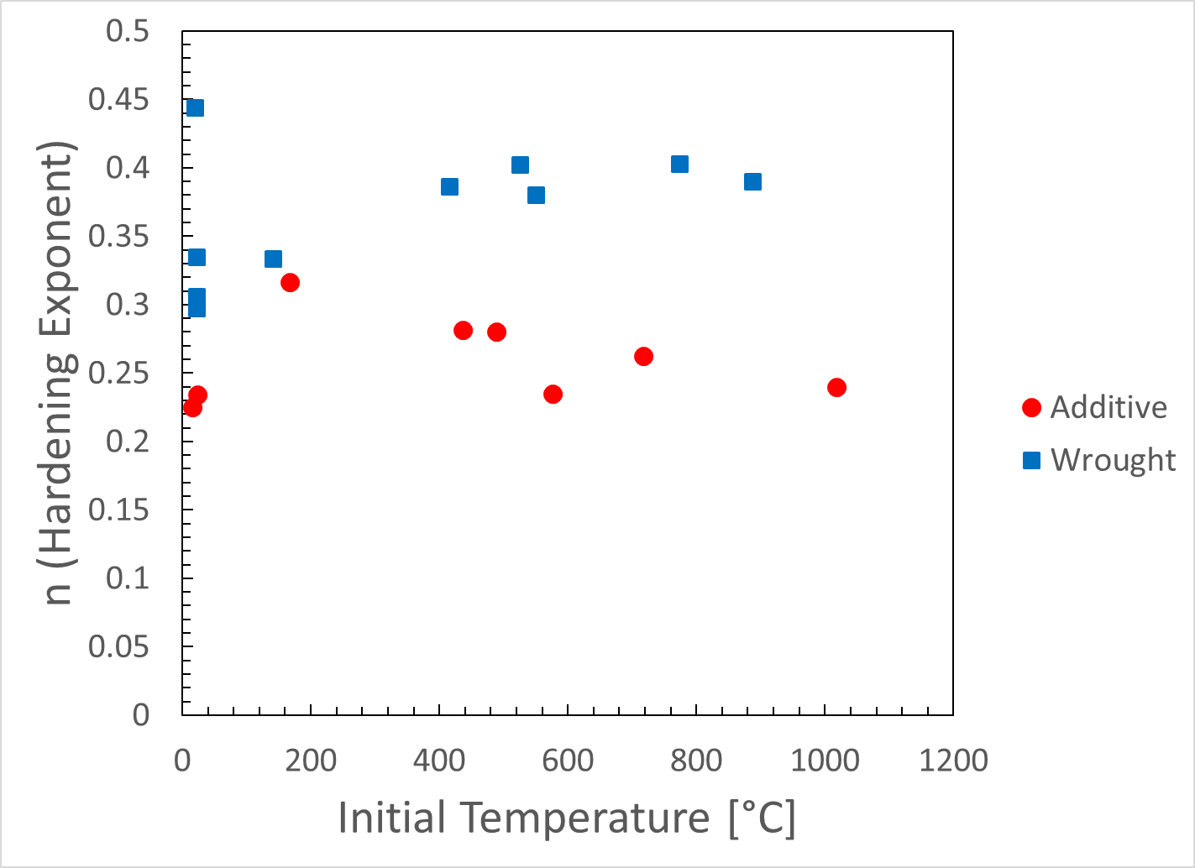
Results: Inconel 625
Additive IN625 shows less hardening capacity compared to wrought
Holloman hardening exponent indicates ductility:
ε_{UTS} ≈ n
σ = κε^{n}

Slide 28
Results: Inconel 625 Machining Behavior
Significant difference in chip morphology
AM IN625 chips are irregular, compared to Wrought IN625 which show regular, periodic segmentation
Tool wear much greater for AM material
Consistent with the presence of small, hard intermetallics in the AM material

Slide 29
Conclusions
Hybrid manufacturing is an important step in bringing “new” additive materials to market
Additively built materials can, despite identical starting chemistries, display very different mechanical properties
Due to significant differences in thermo-mechanical processing routes
AM 17-4 contains significant FCC austenite compared to BCC (martensite) wrought 17-4. The result is different strength and strain hardening behavior below 750 °C (FCC transformation temperature)
Effects on machining behavior to be explored
AM IN625: high temperature intermetallics enhance strength, reduce hardening capacity and ductility up to 1000 °C
AM exhibits different chip morphology and increased tool wear

Slide 30
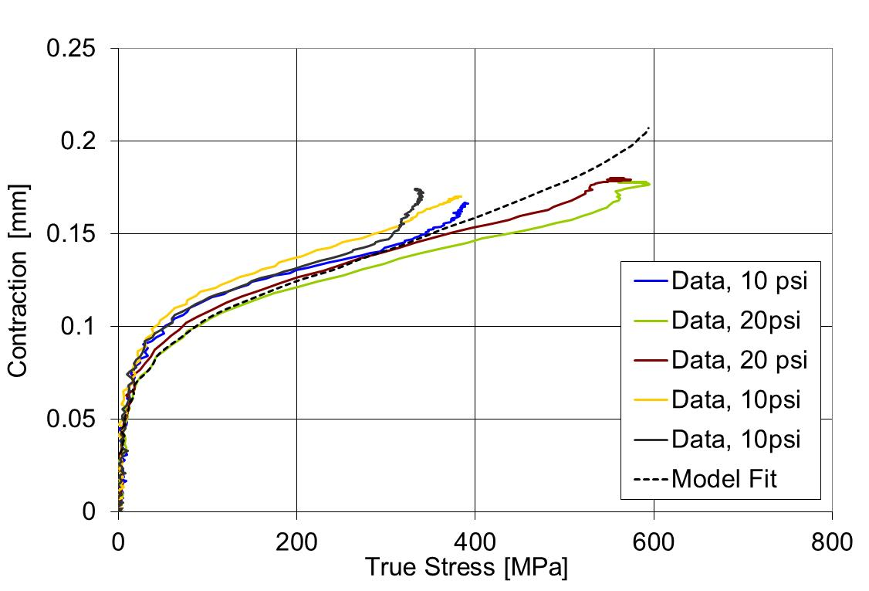
Graphite Foil Correction – Wave Analysis
The strain-time response of the specimen is extracted from reflected pulse data by subtracting the foil contribution from the total displacement between the bars:
sample
contraction
=
total
displacement
-
foil
contraction
A foil contraction model is determined from foil-only measurements (room T and heated)

